Slide 1

Project Name : Completion of Jeddah-Makkah Direct Road
Contractor : Hawazen Al-Jazira Contracting Company
Consultant: Eurogroup Engineering Consulting.
Owner : Ministry Of Transport And Logistic services

Slide 2
General Information
Award Date : | 30/05/2023
Duration of Contract: | (1080) Days
Contractual Completion Date: | 26/04/2026
Original Contract Value : | SAR 277,996,169.50
Variation in Contract Amount: | SAR 307,995,786.45
Variation in Contract Completion date: | 08/09/2027
Value of Work Completed : | SAR 177,163,457.48
% age of Work Completed : | 57.52%

Slide 3
Project Description
Construction of Road Include :
Part2 :Earthwork ( Cut – Fill – subgrade-Structural Excavations for Bridges & Culverts )
Part3 : Aggregate Base Course
Part4 : Bituminous Construction (Bituminous Primer Coat, MC-1- Bituminous Base Course Superpave PG(76-10) - Bituminous Wearing Course Superpave PG(76-10) )
Part5 : Concrete, Steel and Structure (3 Valley Bridge – 12 Box culverts)
Part6 : Incidental Construction(New Jersey Concrete Barrier, Curbstone, Catch Basin, Manholes, Inlets And Drainage Grates, Riprap And Slope Protection)
Part7 : Roadway Lighting
Part9 : Traffic Control Devices (Road Marking And Traffic Signs)

Slide 4
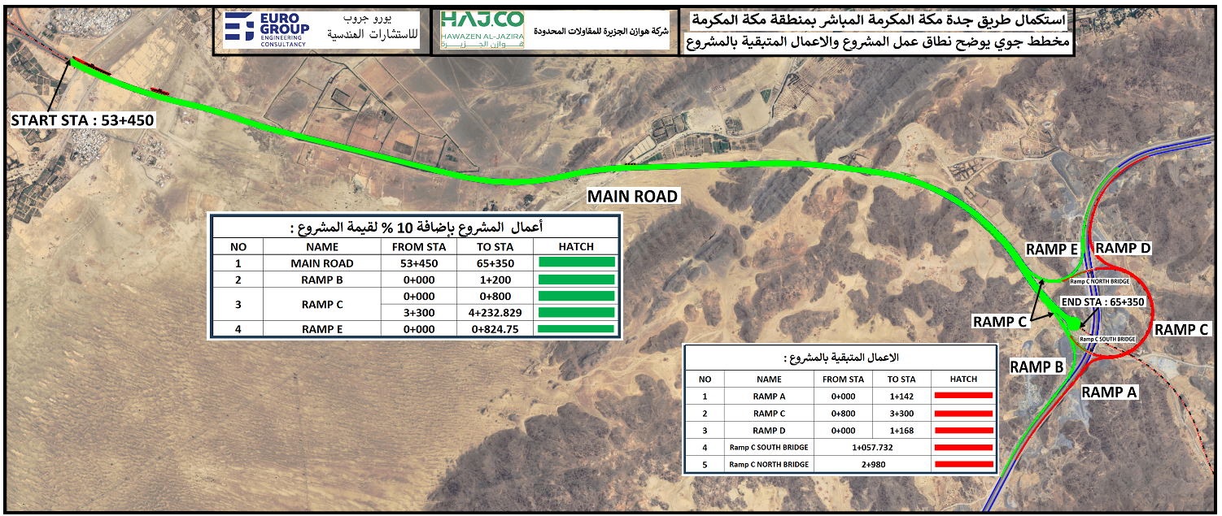
Project General Location

Slide 5
Original Scope of Work
The Original Scope of Work includes the completion of the Jeddah-Makkah direct road from station (53+525) to station (64+500) according to Design plans, with the intersection with the Fourth Ring Road at the station (65+500).
Length = 12.00 KM.
Right of way : 100 m
dualization ( Every side 4 lane & 2 shoulders)
pavement layers:
sub grade : 30Cm
Aggregate Base course : 30 cm
Bituminous Base Course : 20 Cm
Bituminous Wearing Course : 5Cm

Slide 6
Sub-Contracts
 | Scope of Work | Value US$ | Subcontractor Name
1 | New Jersey concrete barriers | 1,066,667 | Nahdat Al-Ejtizaz Contracting
2 | Execution of bridges and culverts | 4,000,000 | Rukn Al-Tameer Company

Slide 7
Human Resources
 | Position | Number of Resources on the project (related to your company only)
1 | Management & Administration | 1
2 | Project Cost & Scheduling | 1
3 | Project Managers | 1
4 | Senior Design Engineers | 2
5 | Design Engineers | 1
6 | Project Engineers | 2
7 | HSE Manager/Officer | 2
8 | Procurement Personnel | 1
9 | Quality Department Personnel | 3
10 | Construction Supervisors | 4
11 | Construction Skilled Labor | 145
12 | Construction Unskilled Labor | 10
Total |  | 173

Slide 8
List Of Equipment
 | Description | Number
1 | Bulldozer | 8
2 | Grader | 6
3 | Excavator | 12
4 | Roller Compactor | 11
5 | Water Tanker | 8
6 | Loader | 6
7 | Truck | 48
8 | Crane | 7
9 | Concrete Pump | 3
10 | Concrete Mixer | 10
11 | Asphalt Paver | 2
12 | Crusher | 2
13 | Concrete patch Plant | 1
14 | Asphalt Patch Plant | 2
15 | MC-1 Tanker | 1
16 | Steel Roller Compactor | 2
17 | Wheels Roller | 4
18 | Small Loader | 2
19 | Fuel Tank | 2
20 | Car Maintenance | 3
Total |  | 140

Slide 9
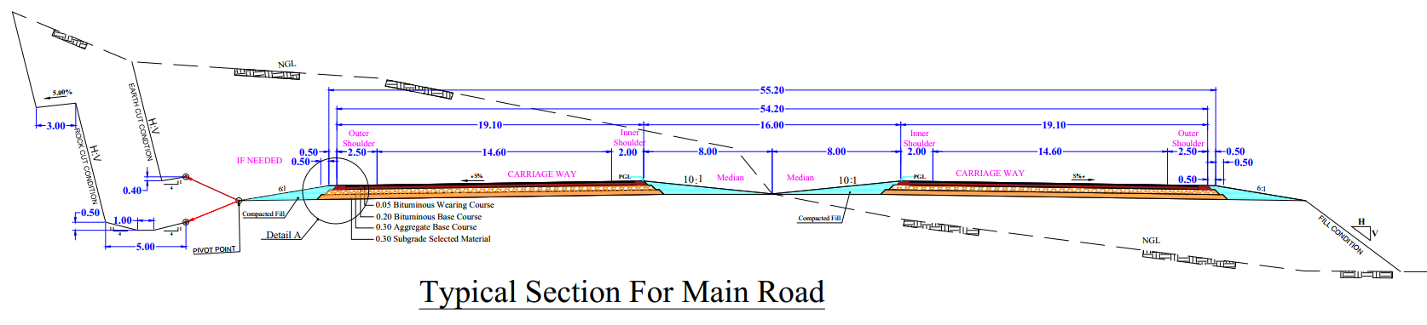
Typical Cross section

Slide 10
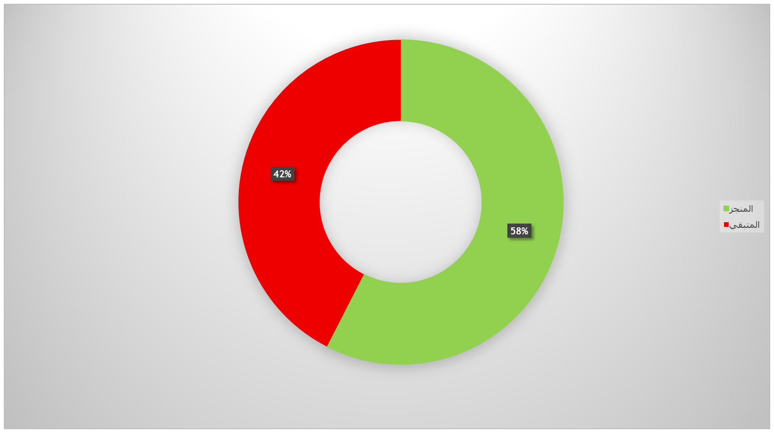
Completion Rate of the Project to Date

Slide 11
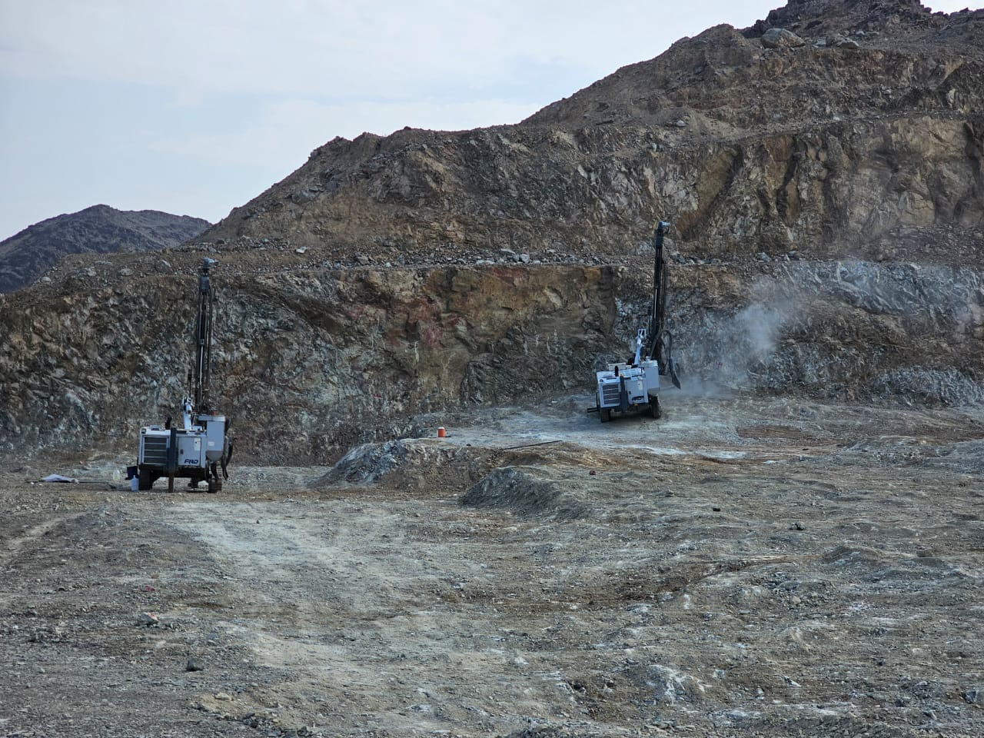
Excavation
Use of Explosives

Slide 12
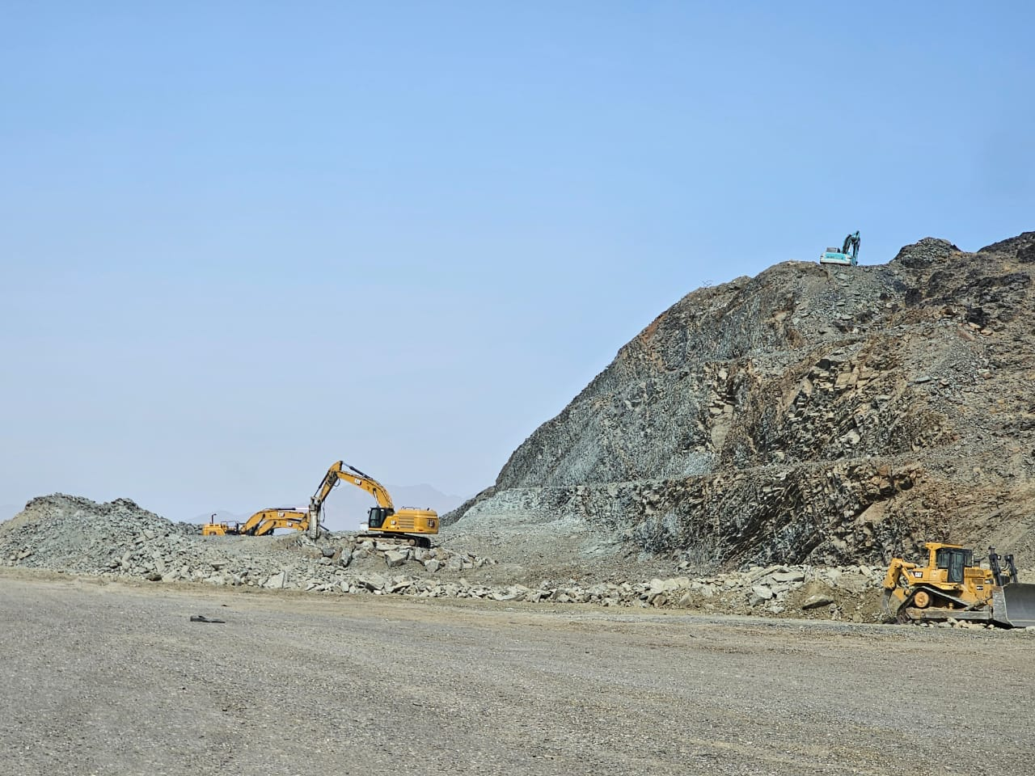
Rock Excavation

Slide 13
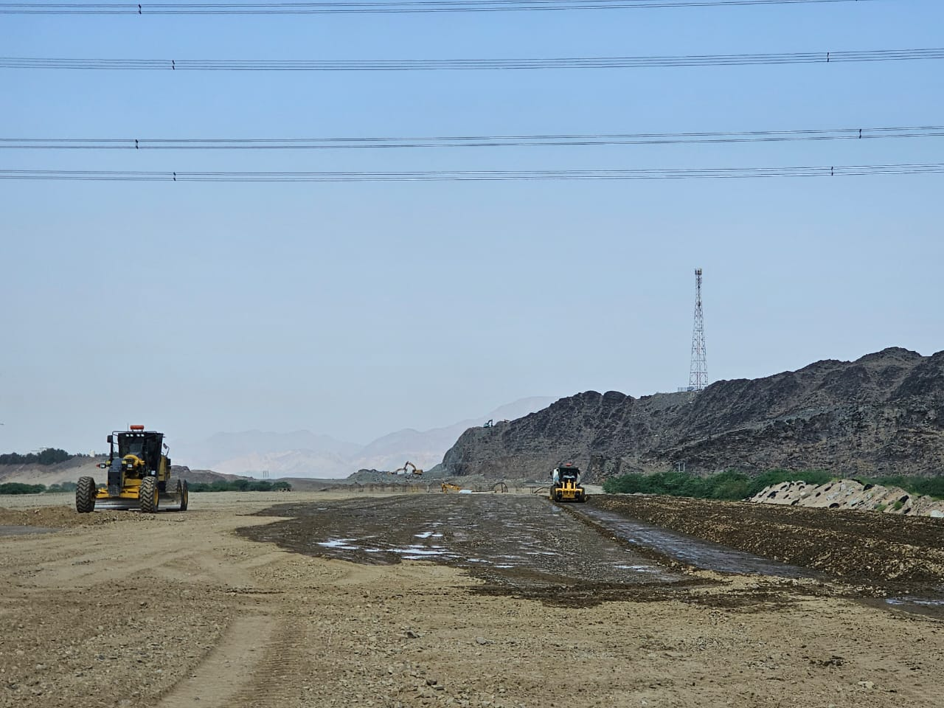
Earthwork (Fill)

Slide 14
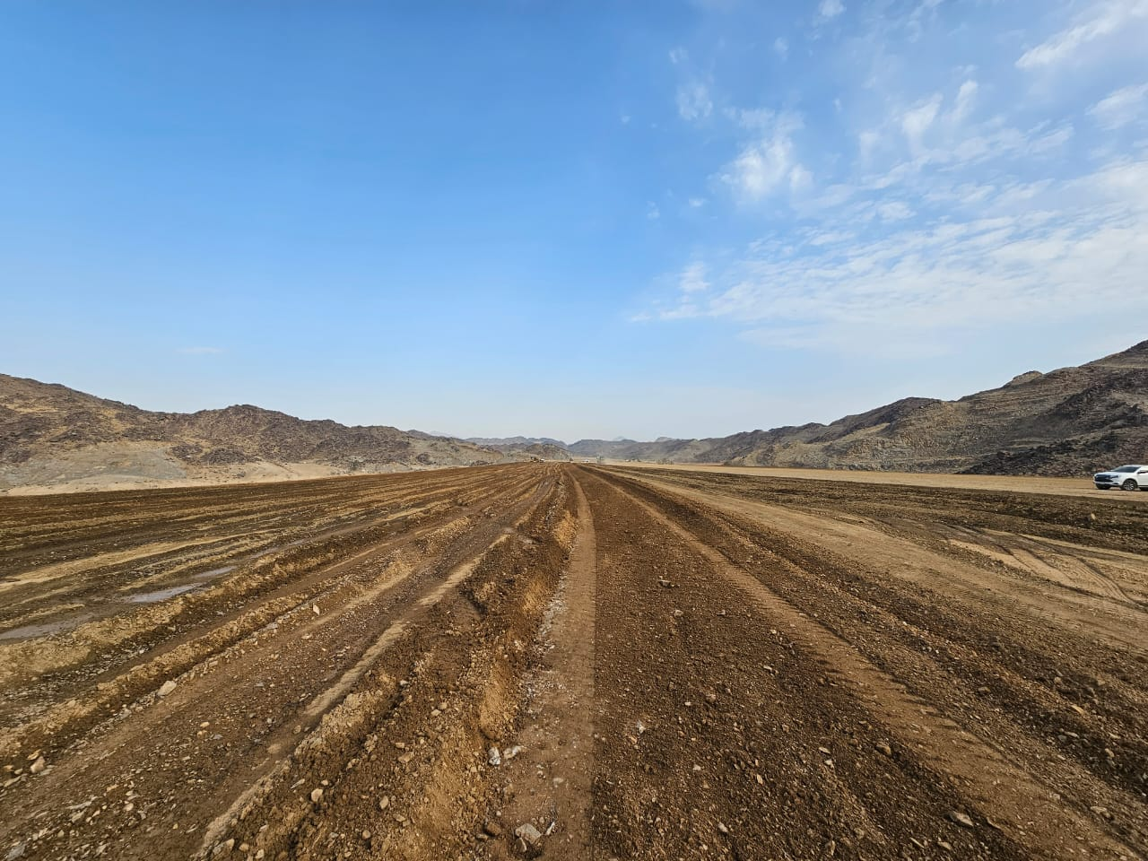
Earthwork (Fill)

Slide 15
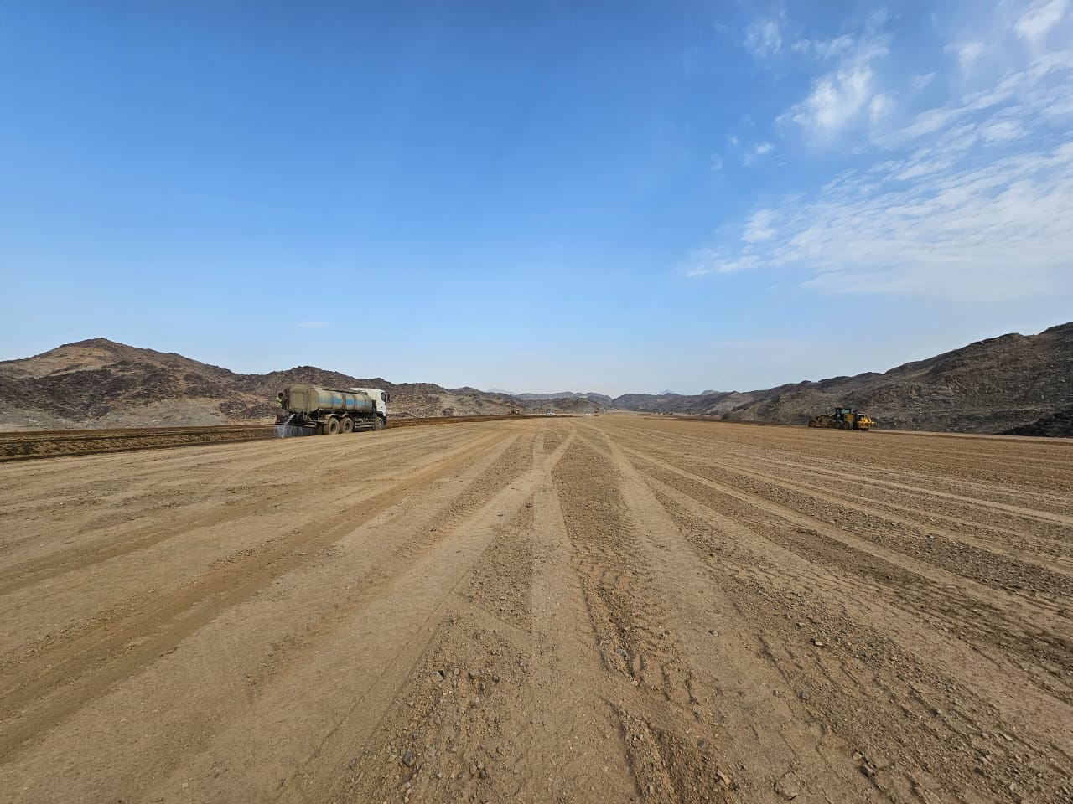
Earthwork (Fill)

Slide 16
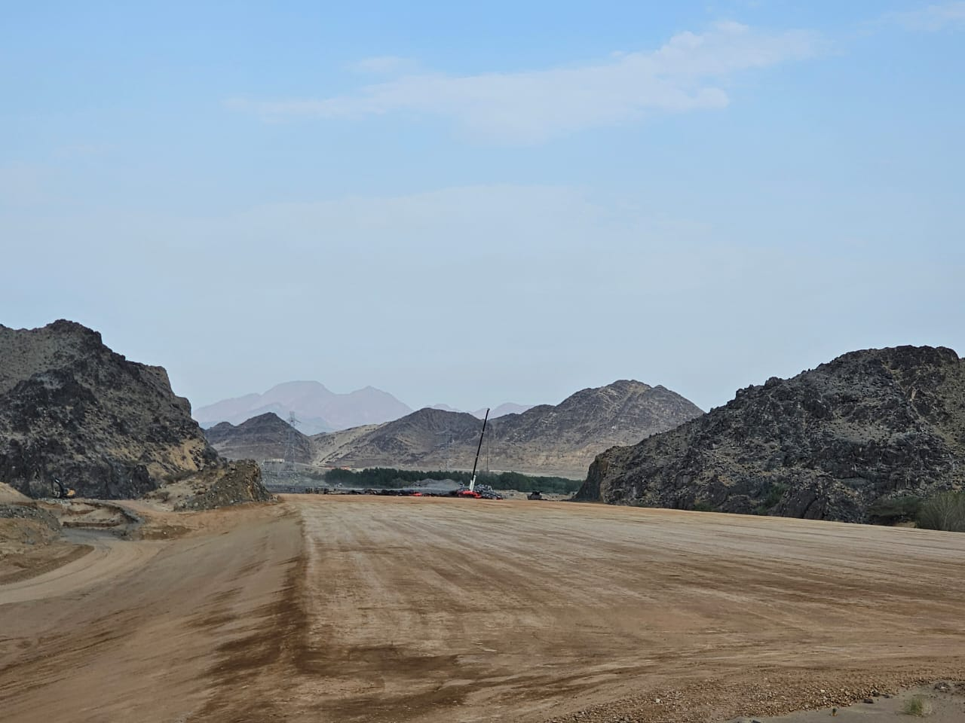
Earthwork (Subgrade)

Slide 17
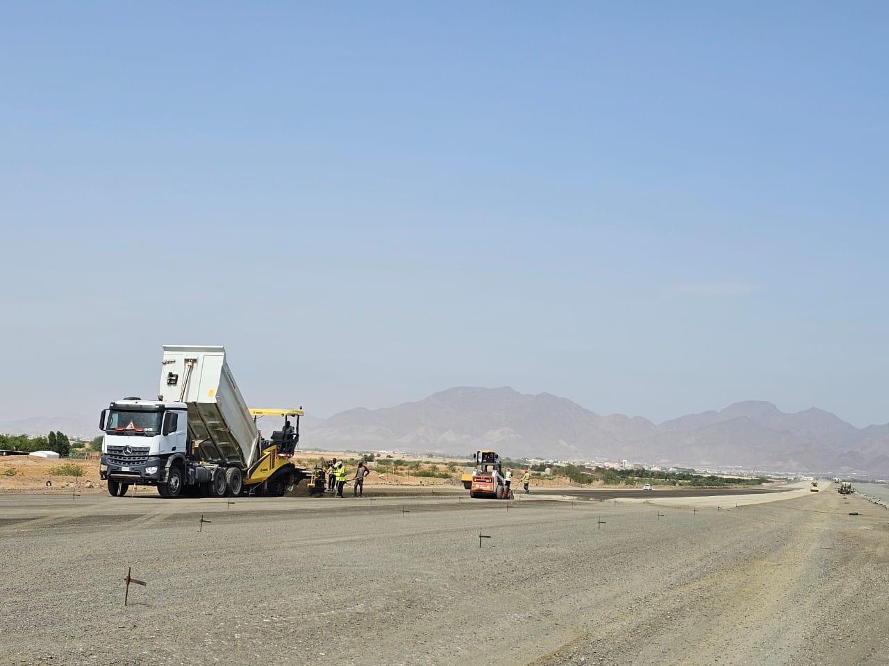
Aggregate Base Course

Slide 18
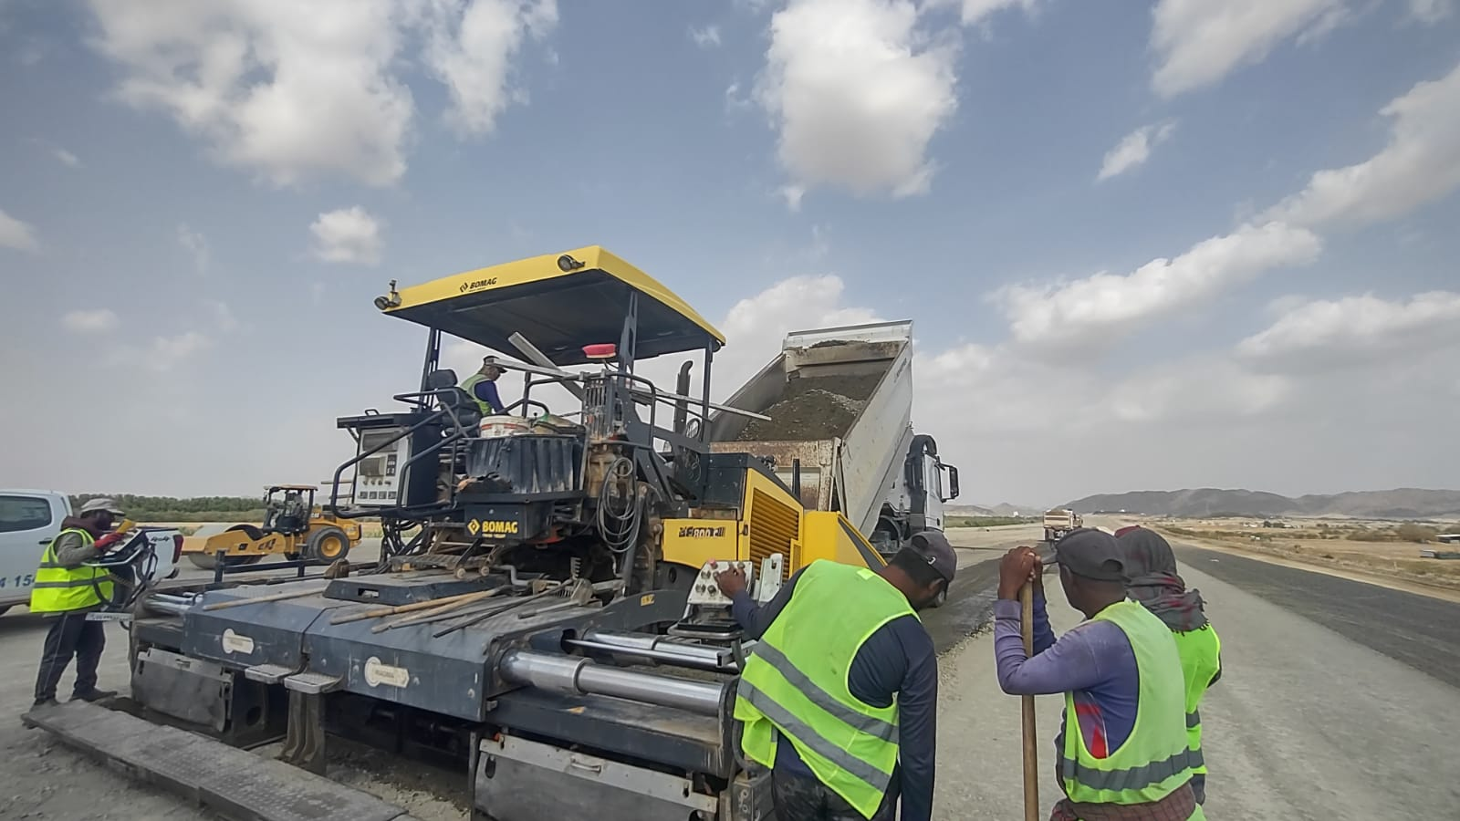
Aggregate Base Course

Slide 19
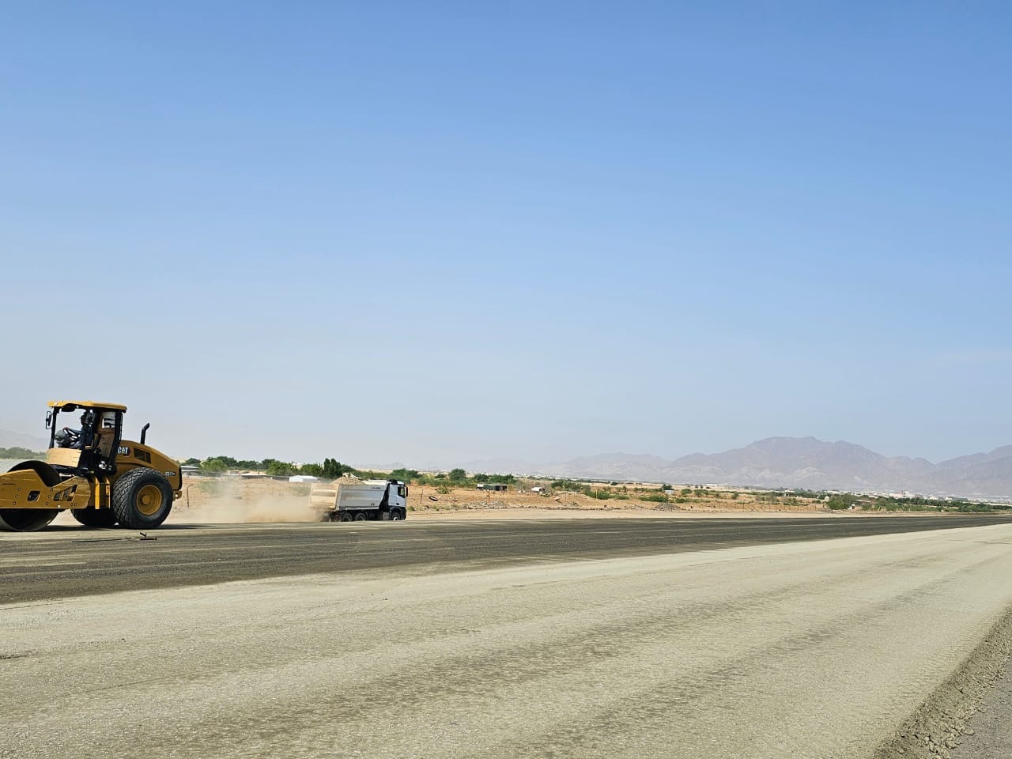
Aggregate Base Course

Slide 20
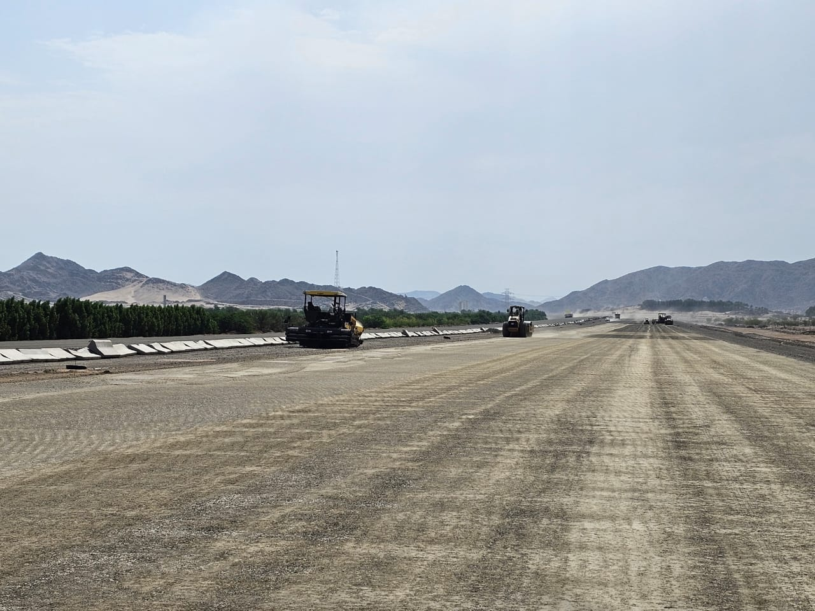
Aggregate Base Course

Slide 21
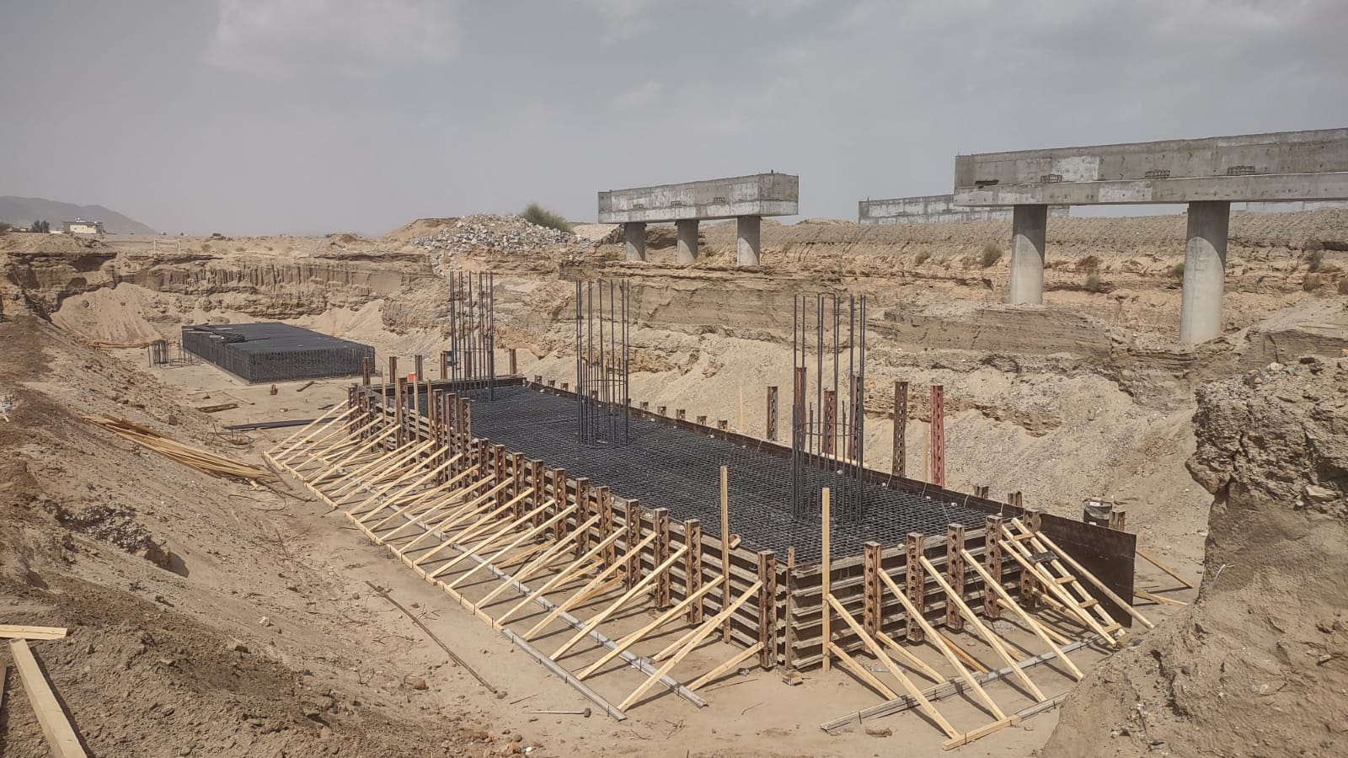
Bridges

Slide 22
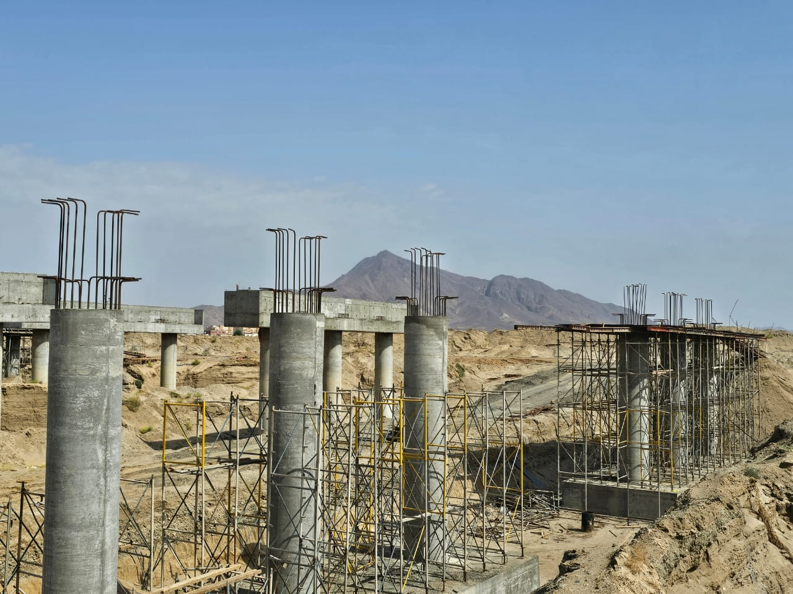
Bridges

Slide 23
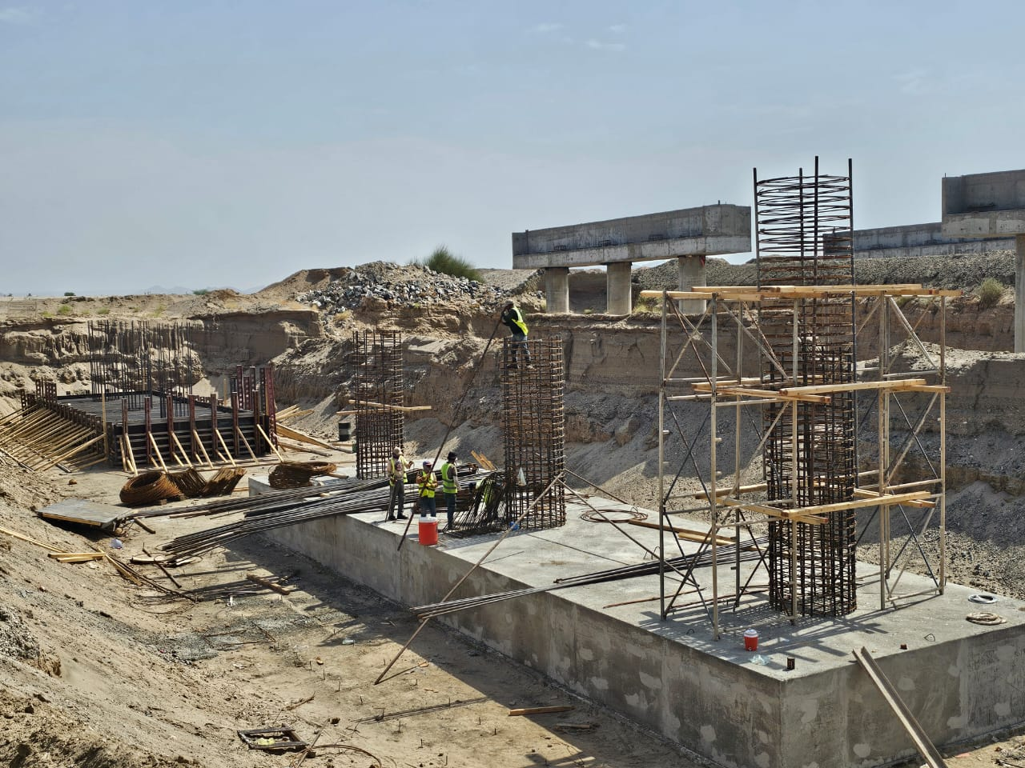
Bridges

Slide 24
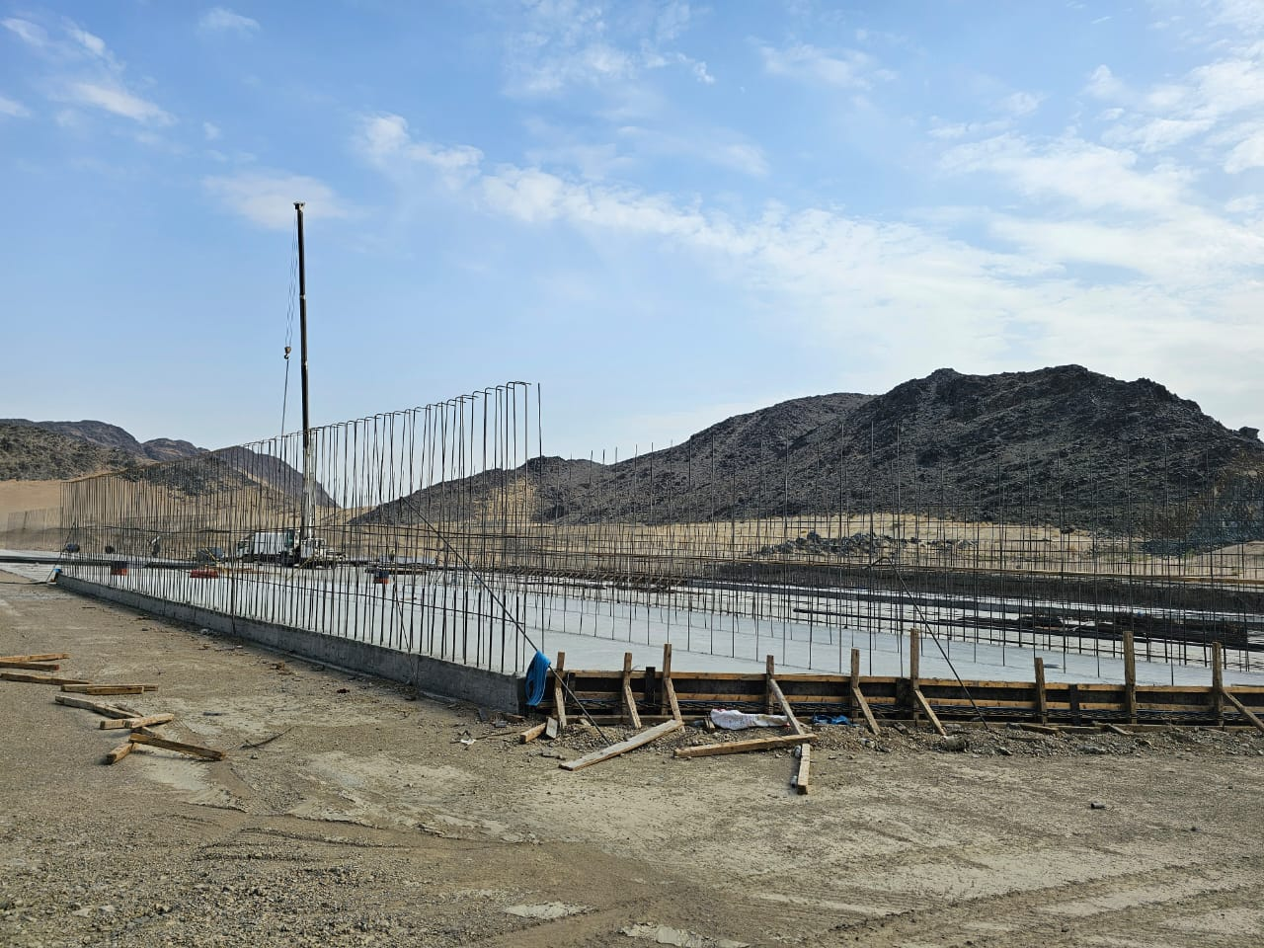
Box Culvert

Slide 25
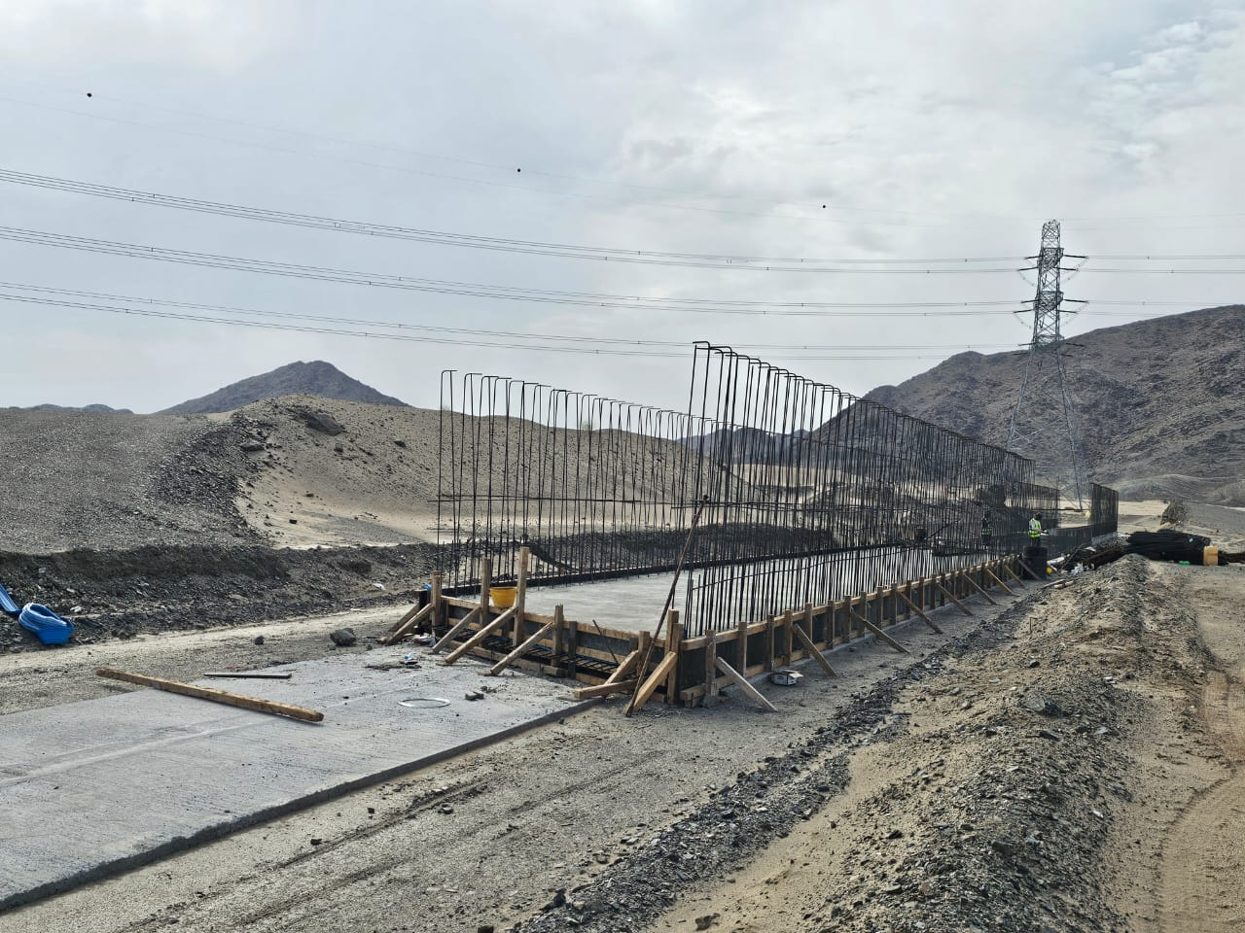
Box Culvert

Slide 26
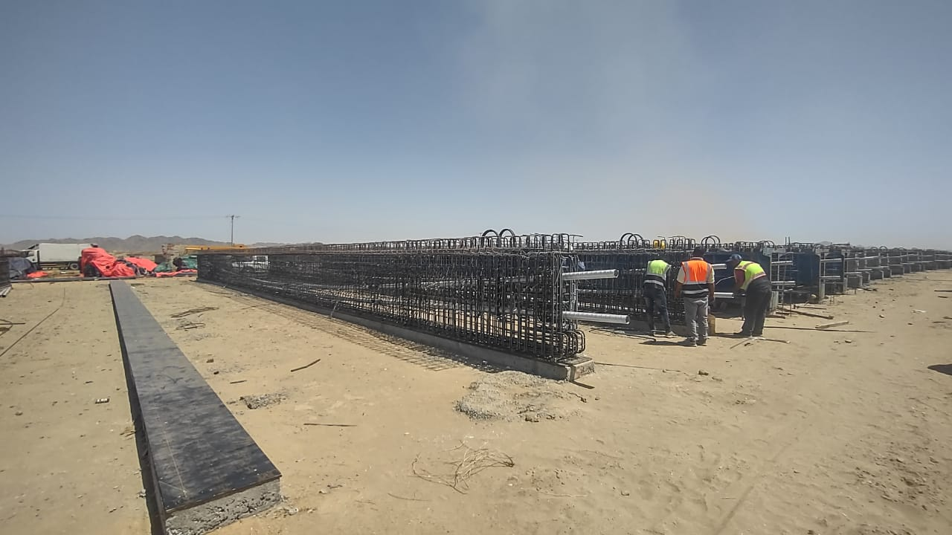
Bridges

Slide 27
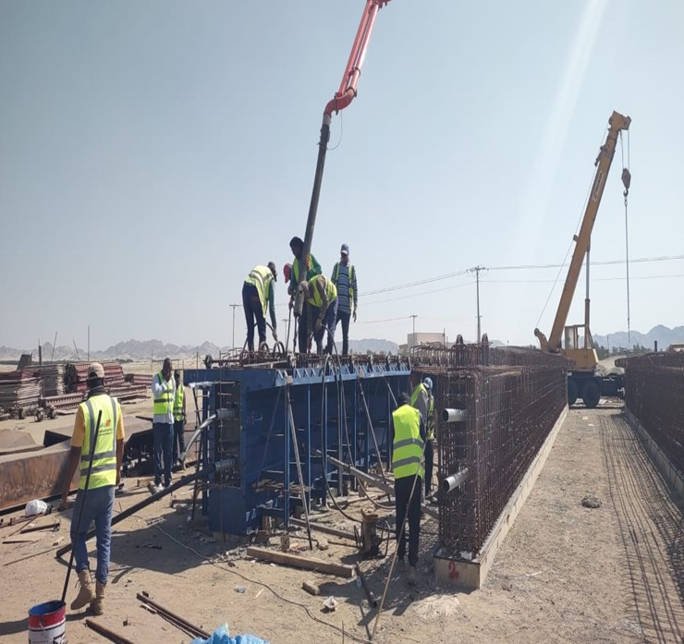
Bridges

Slide 28
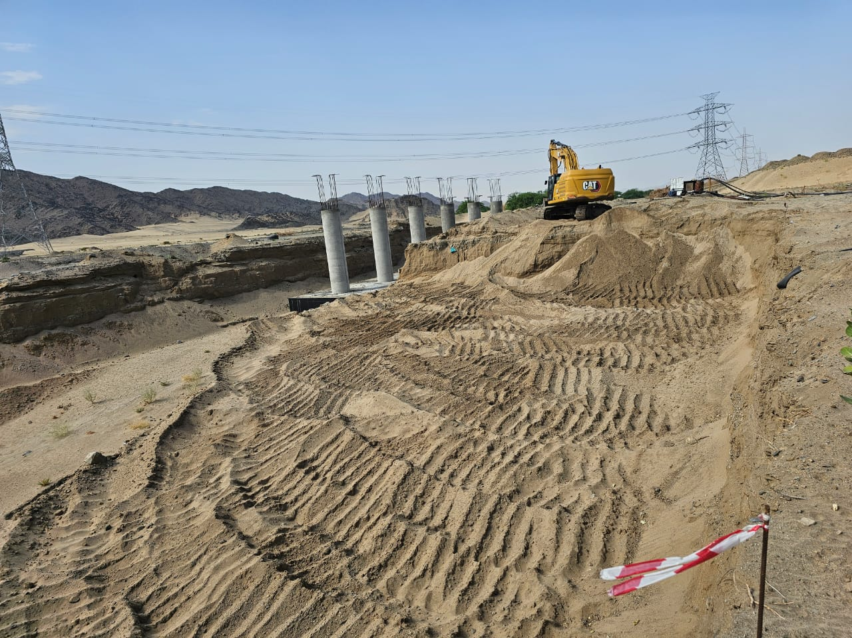
Bridges

Slide 29
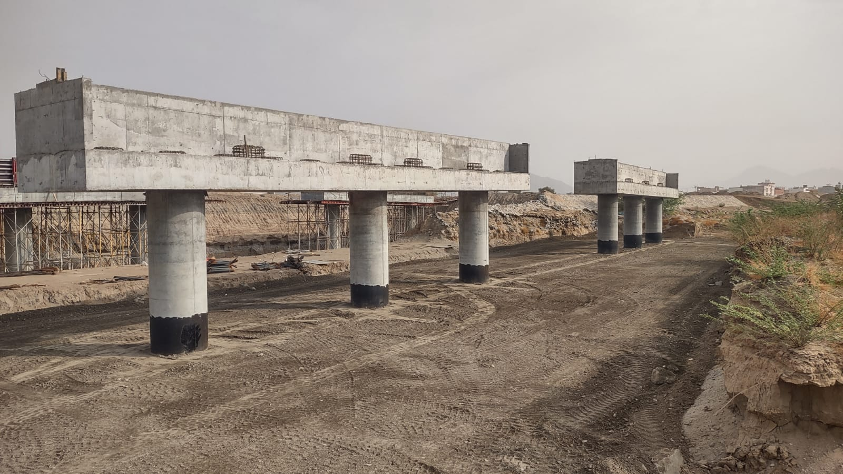
Bridges

Slide 30
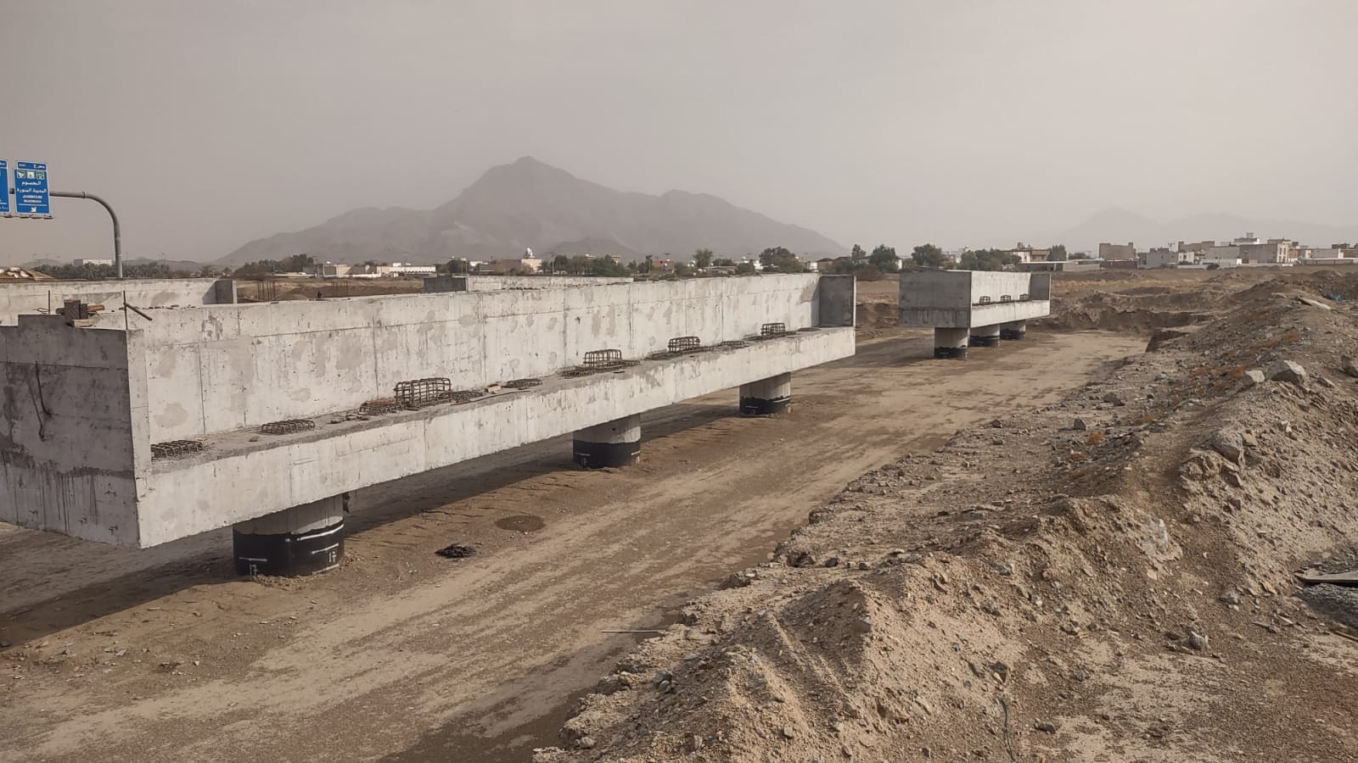
Bridges

Slide 31
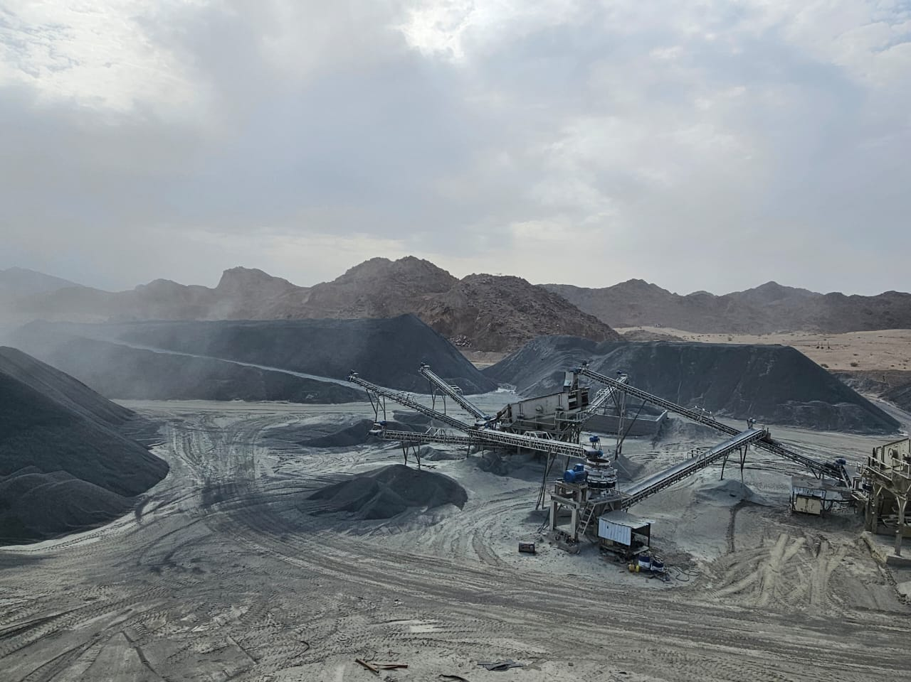
Crushers

Slide 32
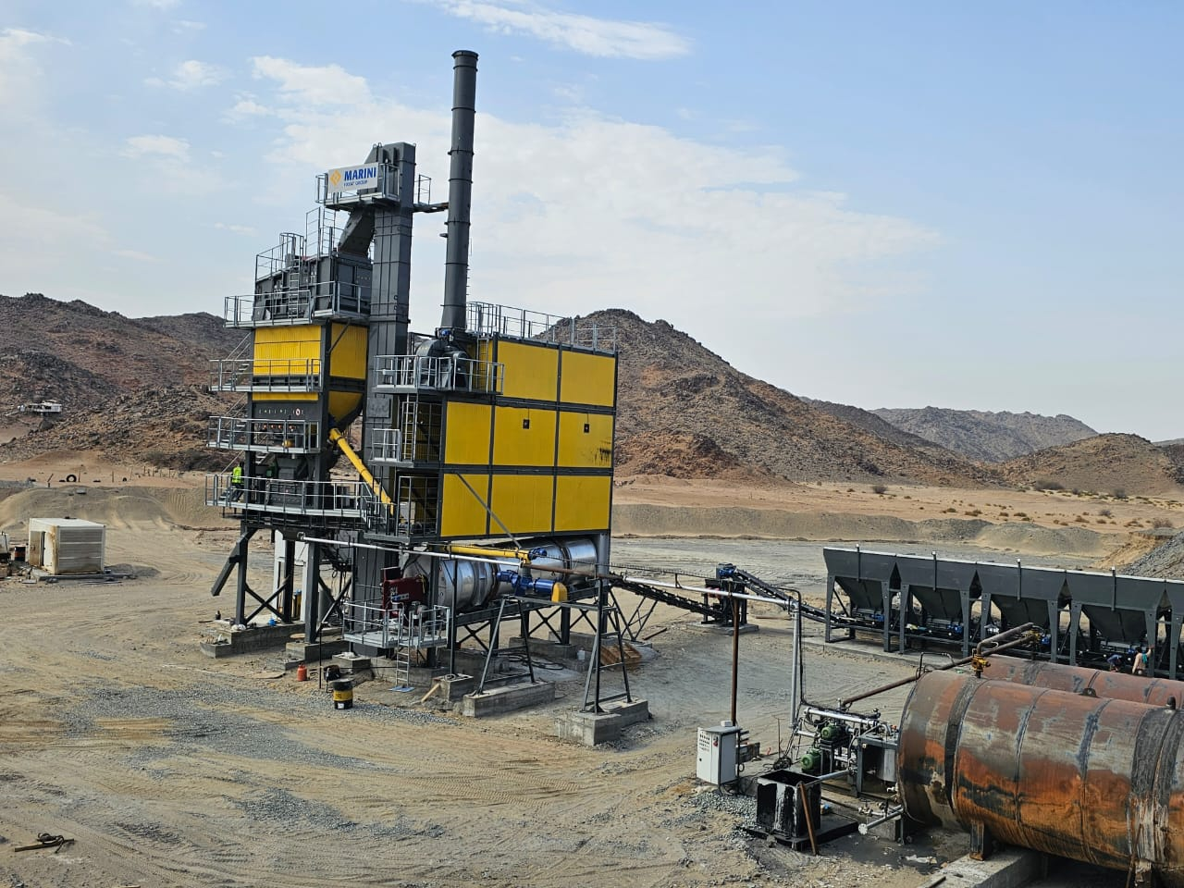
Asphalt Plant

Slide 33
End of presentation

